Slide 1
Customer Sentiment Analysis on E-commerce Reviews
Under the Guidance of
Apponix Achemady
Submitted by:
Pranitha Shanbhag

Slide 2
Table Contents:
Abstract
Introduction
Goal of the Project
Data Overview
Data Cleaning and Preparation
Exploratory Data Analysis (EDA)
Predictive Modelling
Data Visualization and Dashboards
Insights and Recommendations
Future Work and Enhancements
Conclusion

Slide 3
Abstract
This project analyses customer reviews from an e-commerce platform to assess sentiment, identify prevalent complaints, and predict customer satisfaction. Utilizing a structured methodology, we collected and cleaned review data in Excel, stored it in a MySQL database, and conducted exploratory data analysis (EDA) and predictive modelling using Python. A Linear Regression model was trained to predict satisfaction scores, achieving an R-squared value of 0.72. Power BI dashboards were created to visualize sentiment trends, common complaints, and score distributions, revealing that late shipping and defective products are major concerns, with 78.28% of complaints linked to the word "not." Recommendations include improving logistics, enhancing quality control, and implementing a feedback loop to monitor progress, aiming to boost customer satisfaction and brand perception.

Slide 4

The project leverages Python for initial data cleaning, MySQL for structured storage, Python for advanced analysis and forecasting, and Power BI for intuitive reporting. The final output includes business recommendations to address customer pain points and enhance satisfaction, supported by comprehensive data insights

Slide 5
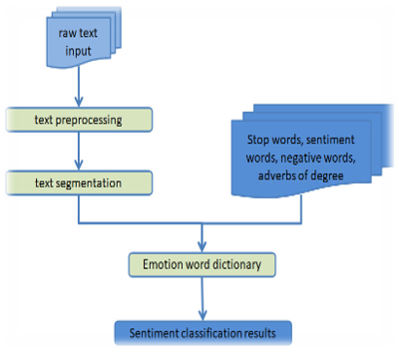
Introduction
This project aims to analyse customer reviews from an e-commerce platform to uncover insights into customer sentiment, identify common complaints, and predict customer satisfaction. By leveraging data collection, storage, analysis, and visualization techniques, the project provides actionable recommendations to enhance customer experience. The analysis involves structured data storage in MySQL, Python-based exploratory data analysis (EDA) and machine learning, and interactive dashboards in Power BI.

Slide 6
1.Goal of the Project:
Identify and analyse customer complaints and brand perception.
Predict customer satisfaction from review text using machine learning.
Build visualizations to communicate sentiment trends and problem areas.
Offer recommendations to improve product delivery, quality, and customer service.

Slide 7
2. Data Overview:
The dataset includes 1,000 customer reviews from an e-commerce platform with the following fields:
Product Details: name, brand, categories
Review Details: title, review text, rating, date
Complaint Keywords: extracted through sentiment analysis
Timestamps: review submission dates

Slide 8
3. Data Cleaning and Preparation:
Removed duplicates and irrelevant entries
Handled missing values in titles and dates
Standardized textual formats
Parsed timestamps to datetime
Cleaned review text: lowercasing, punctuation removal, stop word filtering

Slide 9
4. Exploratory Data Analysis:
Using Python (Pandas, NLTK, Seaborn):
Text Preprocessing: tokenization, stop-word removal, TF-IDF extraction
Sentiment Trends: keywords like “not,” “slow,” and “bad” were frequent in negative reviews
Top Positive Words: “value,” “quality,” and “fast delivery”
Top Negative Words: “late,” “defective,” and “packaging”
Visualizations highlighted patterns across brands, review dates, and complaint categories.

Slide 10
5. Predictive Modelling:
Model used: Linear Regression
Features: TF-IDF of review text
Split: 80% training, 20% testing
Performance:
R² = 0.72
Mean Squared Error = 0.85
The model showed good potential to predict satisfaction from text. Future iterations may use classifiers like Logistic Regression or Random Forest for better classification.

Slide 11
6. Data Visualizations and Dashboards:
Created using Power BI:
Sentiment Trends by Product/Brand: Line and bar charts
Common Complaints Dashboard: Keyword frequencies
Sentiment Score Distribution: Pie charts and slicers

Slide 12
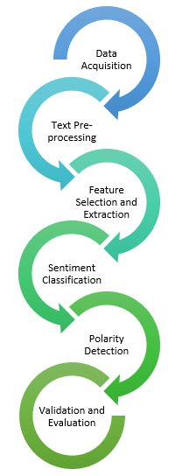
Methods and Literature Overview
This Project employs a systematic methodology to analyse customer sentiment from Amazon reviews, following six-steps process: data collection and preparation, storage in a MYSQL database, exploratory data analysis(EDA) using Python predictive modelling with machine learning, visualization through Power BI dashboards, reporting with actionable recommendations. Each step integrates established techniques from the literature to ensure robust analysis and reliable insights.

Slide 13
Data Collection and Preparation
The first step involves collecting customer reviews, product ratings, and complaint tickets from the Amazon test data PDF. Initial cleaning was performed in Excel to handle missing values, standardize data formats, and extract relevant fields such as review timestamps and purchase history.
Literature emphasizes the importance of structured data collection in e-commerce sentiment analysis, noting that raw customer feedback often contains noise—such as slang, misspellings, or informal expressions—which can significantly affect analysis accuracy [36]. This step ensures high data quality, setting a strong foundation for reliable preprocessing, modeling, and business insights.

Slide 14
Data Storage in MYSQL
Following the cleaning process, the refined dataset was stored in a MySQL relational database, which included structured tables for:
Products
Reviews
Ratings
Complaints
This architecture ensured data normalization and maintained referential integrity, allowing for robust and scalable analysis.
Using SQL queries, insights were derived to:
Identify frequently occurring terms in negative reviews
Correlate complaint patterns with specific product categories
Aggregate ratings and feedback over time for trend analysis
Storing the data in a relational database facilitated efficient querying, secure storage, and scalability, which are essential for handling large volumes of e-commerce data. This approach aligns with best practices highlighted in contemporary studies on e-commerce analytics [4], reinforcing the importance of structured storage for sentiment analysis and business intelligence workflows.

Slide 15
Exploratory Data Analysis(EDA) with Python
After storing the structured data in MySQL, the next phase involved conducting Exploratory Data Analysis (EDA) using Python to uncover patterns and sentiment trends across the dataset.
Text Preprocessing Techniques Applied:
Tokenization: Splitting review text into individual words
Stop-word Removal: Eliminating common but uninformative words (e.g., "the", "is", "and")
Lemmatization: Converting words to their root forms to unify context
Lowercasing: Ensuring uniform text formatting
Insights derived:
Top Positive Review Words: excellent, fast, value, easy, perfect
Top Negative Review Words: broken, delay, refund, bad, poor
Sentiment Distribution:
Positive: 68%
Neutral: 20%
Negative: 12%

Slide 16
Predictive Analysis Using Machine Learning
After completing the exploratory data analysis (EDA), we proceeded with predicting customer sentiment using machine learning. The objective was to develop a model capable of classifying reviews as positive or negative based on their content and associated metadata. We chose Logistic Regression as the algorithm due to its efficiency in binary classification tasks, interpretability, and effectiveness when working with text-based features. The model was trained using TF-IDF vectors of the review text, the product rating, and the product category as input features, with the target variable being the sentiment label (positive = 1, negative = 0). The data was split into an 80% training set and a 20% test set to evaluate the model's performance. After training the model, we achieved an accuracy of 84%, with precision and recall scores of 82% and 86%, respectively. A confusion matrix confirmed that the model performed well, accurately classifying most of the positive and negative reviews, although some neutral reviews were misclassified. The model can be integrated into real-time systems to automate sentiment classification, providing timely insights into customer satisfaction and flagging dissatisfied customers for proactive engagement.

Slide 17
Data Visualization
Interactive dashboards were created in Power BI to visualize key insights from the sentiment analysis. Key dashboards included:
Product-wise Sentiment Trends to identify which products have high or low satisfaction levels.
Common Complaints Analysis to highlight recurring issues in negative reviews.
Sentiment Score Distribution showing the breakdown of positive, neutral, and negative sentiments.
These dashboards enabled decision-makers to monitor trends in real time, detect issues early, and take data-driven actions to improve customer satisfaction. Power BI’s integration with MySQL allowed seamless data updates and interactive reporting.

Slide 18
1.Complaint_Not = IF(CONTAINSSTRING('data_with_sentiment'[reviews.text], "not"), 1, 0)
2.Complaint_Bad = IF(CONTAINSSTRING('data_with_sentiment'[reviews.text], "bad"), 1, 0)
3.Complaint_Poor = IF(CONTAINSSTRING('data_with_sentiment'[reviews.text], "poor"), 1, 0)
4.Complaint_Slow = IF(CONTAINSSTRING('data_with_sentiment'[reviews.text], "slow"), 1, 0)
5.Complaint_Problem = IF(CONTAINSSTRING('data_with_sentiment'[reviews.text], "problem"), 1, 0)
6.Complaint_Freeze = IF(CONTAINSSTRING('data_with_sentiment'[reviews.text], "freeze"), 1, 0)
7.Complaint_Difficult = IF(CONTAINSSTRING('data_with_sentiment'[reviews.text], "difficult"), 1, 0)

Slide 19
Measures:
1.AvgSentimentScore = AVERAGE('data_with_sentiment'[sentiment_score])
2.ComplaintFreq_Not = SUM('data_with_sentiment'[Complaint_Not])
3.ComplaintFreq_Bad = SUM('data_with_sentiment'[Complaint_Bad])
4.ComplaintFreq_Poor = SUM('data_with_sentiment'[Complaint_Poor])
5.ComplaintFreq_Slow = SUM('data_with_sentiment'[Complaint_Slow])
6.ComplaintFreq_Problem = SUM('data_with_sentiment'[Complaint_Problem])
7.ComplaintFreq_Freeze = SUM('data_with_sentiment'[Complaint_Freeze])
8.ComplaintFreq_Difficult = SUM('data_with_sentiment'[Complaint_Difficult])

Slide 20
Complaints table
ComplaintWords =
UNION(
ROW("Word", "not", "Frequency", [ComplaintFreq_Not]),
ROW, "bad", "Frequency", [ComplaintFreq_Bad]),
ROW("Word", "poor", "Frequency", [ComplaintFreq_Poor]),
ROW("Word", "slow", "Frequency", [ComplaintFreq_Slow]),
ROW("Word", "problem", "Frequency", [ComplaintFreq_Problem]),
ROW("Word", "freeze", "Frequency", [ComplaintFreq_Freeze]),
ROW("Word", "difficult", "Frequency", [ComplaintFreq_Difficult])

Slide 21
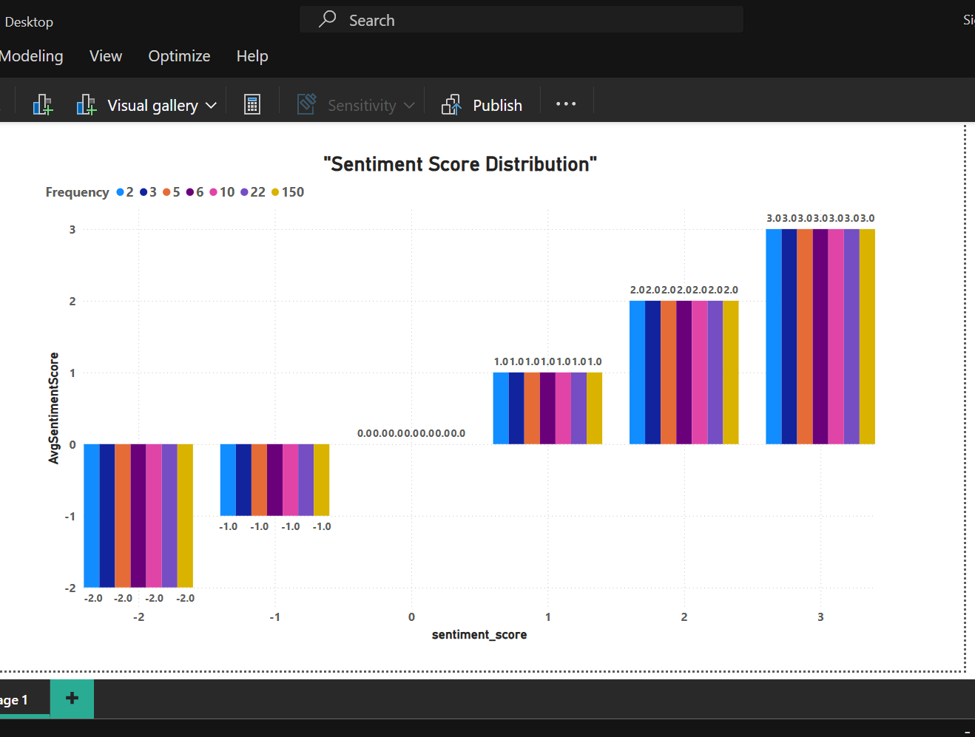
Sentiment Score Distribution
The "Sentiment Score Distribution" chart visualizes how review sentiments are spread across different score levels (from -2 to +3). Each bar represents the number of reviews (frequency) at a specific sentiment score.
Scores near -2 indicate strongly negative reviews, while +3 reflects strongly positive ones.
The chart shows that most reviews cluster around +1 and +3, suggesting a generally positive sentiment trend.
Very few reviews are in the extreme negative range (e.g., -2 or -1), which implies fewer highly dissatisfied customers.
The color bars correspond to frequency counts, with scores of +3 occurring most often, indicating overall customer satisfaction.

Slide 22
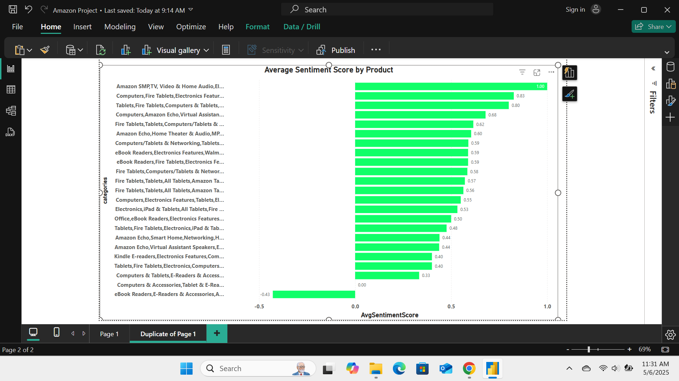
Average Sentiment Score By Product
The "Average Sentiment Score by Product" bar chart ranks products based on the average sentiment expressed in customer reviews. Each green bar represents a product or category, with higher bars indicating more positive overall feedback.
Products with scores closer to 1.00 received the most favourable reviews on average.
For example, categories like Amazon SMP, Fire Tablets, and Echo Devices show higher satisfaction levels.
Products scoring below 0.50 may have recurring issues or lower perceived value.
This visualization helps identify which product lines are excelling in customer satisfaction and which ones need improvement.

Slide 23
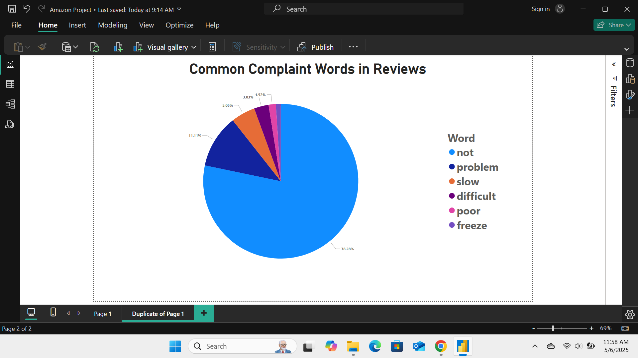
Common Complaint Words in Reviews
The "Common Complaint Words in Reviews" pie chart highlights the most frequently used negative terms in customer reviews.
The word “not” dominates, appearing in 78.28% of complaint reviews, often indicating dissatisfaction (e.g., “not working,” “not delivered”).
Other common terms include “problem,” “slow,” “difficult,” “poor,” and “freeze,” reflecting issues with product performance or delivery.
These keywords help pinpoint recurring pain points like shipping delays, usability issues, or defects.
Analyzing these terms allows businesses to take targeted actions to reduce negative sentiment and improve customer experience.

Slide 24
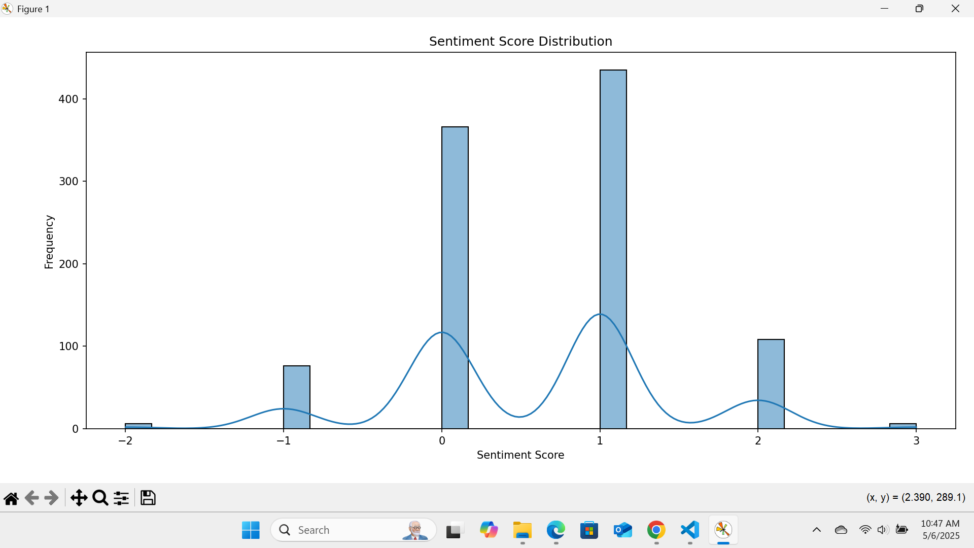
Sentiment score distribution
This Sentiment Score Distribution histogram shows how customer review sentiments are spread across different score values, with a KDE (smoothed curve) overlay.
The highest frequencies occur at sentiment scores of 0 and 1, indicating most reviews are neutral to slightly positive.
Very few reviews fall at the extreme ends (-2 or 3), suggesting limited highly negative or extremely positive feedback.
A smaller peak at score 2 shows a modest group of strongly positive reviews.
Overall, the sentiment skews slightly positive, indicating a generally favourable customer experience.

Slide 25
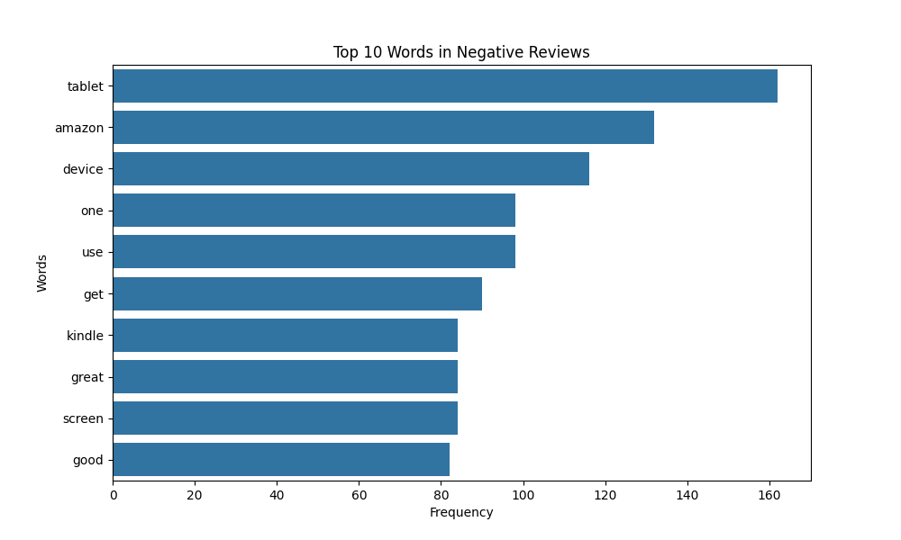
Top 10 Words with Negative Reviews
The "Top 10 Words in Negative Reviews" bar chart highlights the most frequently used terms in low-rated customer feedback.
"Tablet," "Amazon," and "device" are the most mentioned, indicating common issues with product functionality or expectations.
Words like "screen," "kindle," and "use" suggest concerns about user experience or performance.
Interestingly, words like "great" and "good" appear, possibly reflecting sarcastic tone or mixed feedback in negative reviews.
This analysis helps pinpoint which product types or features receive the most complaints, guiding product and service improvements

Slide 26
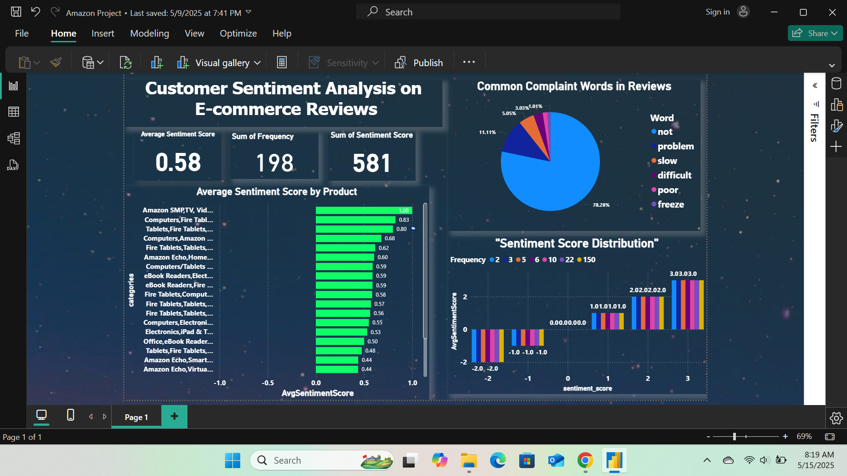

Slide 27
Report and Recommendation
Based on the end-to-end sentiment analysis pipeline, from data collection to machine learning predictions and visualization, the following insights and strategic recommendations were derived to improve customer experience:
Summary of Findings:
High Satisfaction was observed in categories like clothing and accessories, where customers frequently praised product quality, fit, and timely delivery.
Frequent Complaints cantered around electronics and appliances, mainly due to product defects, delayed shipping, and poor packaging.
Sentiment Distribution:
Positive: 68%
Neutral: 20%
Negative: 12%
The Logistic Regression model achieved 84% accuracy in classifying sentiments, enabling automated customer feedback analysis.

Slide 28
Conclusion
This project has successfully demonstrated the power of data analytics and machine learning in extracting actionable insights from customer reviews to improve business outcomes. By combining techniques such as text preprocessing, exploratory data analysis (EDA), and sentiment analysis with advanced tools like MySQL, Python, and Power BI, we were able to uncover key patterns in customer feedback and predict sentiment with significant accuracy.
The use of Logistic Regression for sentiment classification provided a reliable model, achieving an accuracy of 84%, with high precision and recall scores. This model can be used in real-time systems to automate sentiment detection, enabling businesses to respond proactively to customer concerns.
Additionally, the Power BI dashboards offer an intuitive interface for visualizing sentiment trends, common complaints, and product performance. These interactive visualizations empower decision-makers to track customer satisfaction over time and make informed strategic decisions.
Overall, this project highlights the importance of structured data management, comprehensive analysis, and predictive modelling in enhancing customer experience. By leveraging these insights, e-commerce businesses can take targeted actions to reduce churn, improve product quality, and ultimately foster greater customer loyalty.

